Slide 1
ENTERPRISE CCTNS 2.0 SOLUTION ALONG WITH OPERATION & MAINTENANCE OF CCTNS 1.0 SYSTEM FOR MAHARASHTRA POLICE
RFP sections and main points

Slide 2
Volumemetrics

Slide 3
Application
The Crime and Criminal Tracking Network Systems (CCTNS) was conceptualized by the Ministry of Home Affairs
The scope of CCTNS spans all 35 States and Union Territories and covers all Police Stations (15,000+ in number) and all Higher Police Offices (7,000+ in number) in the country.
MHA and NCRB played a key role in planning the program in collaboration with the Police leadership within States, in the development of a few core components and in monitoring and reviewing the program
Maharashtra was one of the CAS states which has used NCRB developed CAS, and CCTNS application went live on 15th Sep 2015.

Slide 4
Application
certain external integration like CCTNS- CCTV (Pune & Mumbai), CCTNS- IGR, CCTNS- AMBIS (Automated Multi-Modal Biometric Identification System), CCTNS- PRISM and CCTNS- ICJS.
Maharashtra Police has decided to migrate current CAS into “Enterprise CCTNS 2.0” built on latest technology and advanced functionalities to enhance the capabilities of the applications having workflow-based environment.

Slide 5
Scope of Work
O and M of CCTNS 1.0 ------The successful bidder is expected to take over the operations and maintenance for the current CCTNS 1.0 application till the successful Go-live of 2.0 application is achieved. This includes operations and maintenance of 1. Support for CAS application software, including OS upgradation as required. 2. Cloud infra managed services 3. Application managed services 4. Helpdesk Manpower required to conduct the above-mentioned activities should be deployed onsite at CID office, Pune.
Design, Implementation and Maintenance of CCTNS 2.0 application span of 3 more years based on the decision of DG office with terms and conditions

Slide 6
Scope of Work ……
Stakeholders
• Citizens/ Citizens groups • State Police department • MHA/NCRB/Others RFP for Selection of SI for Design, Development, Implementation & Maintenance of CCTNS 2.0 along with O&M for CCTNS 1.0 System 25 | P a g e Issued by DGP Office, Government of Maharashtra • External Departments of the State such as Courts, Passport Office, IGR, FSL, Prosecution, Transport Department, Hospitals etc. • Other Law enforcement agencies like CBI, IB, etc. • Non-Government/Private sector organizations

Slide 7
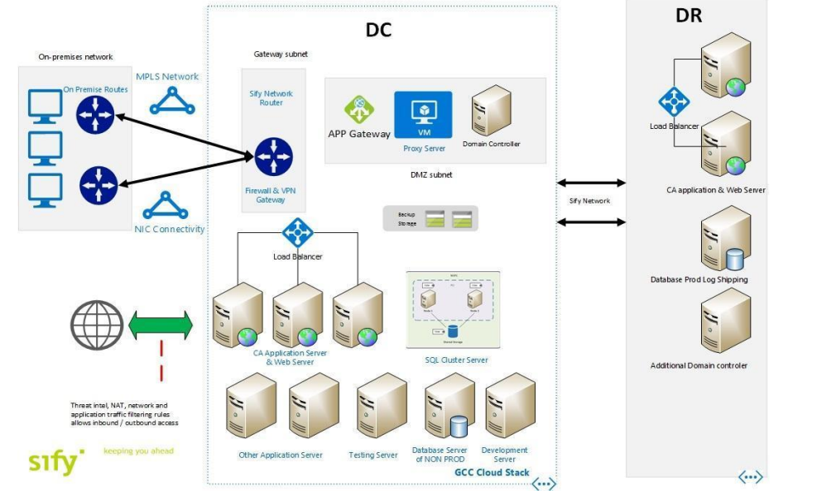
Infrastructure (Existing Data Center Infrastructure )
Presently, as per Maharashtra Government – Cloud Policy, CCTNS Maharashtra has migrated CAS4.5 on Cloud Platform. All Police Stations, Sub-Divisional Police Offices, all Police Districts / Commissionerate and other Unit Headquarters in the Department are connected to the Sify Data Centre (MSP). Microsoft and Sify Limited is the CSP and MSP for the existing legacy application/system that is currently deployed on cloud platform as per the DIT, Government of Maharashtra guidelines. CCTNS, project currently has the Azure Virtual Network service, which securely connects Azure resources to one another by using virtual networks. A virtual network is a representation of your own network in the cloud. A virtual network is a logical isolation of the Azure cloud dedicated to subscription

Slide 8
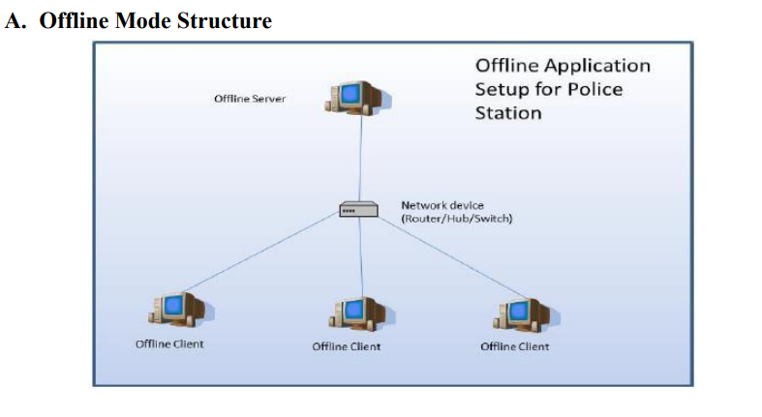
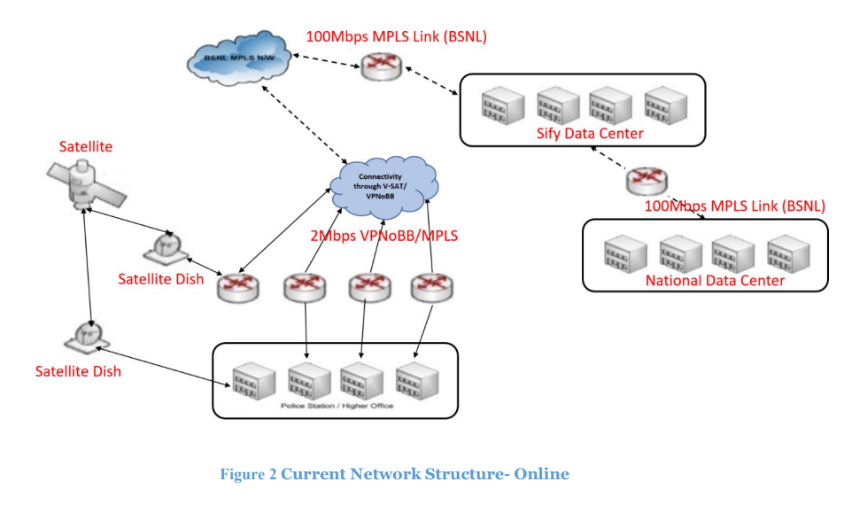
Infrastructure (Existing Data Center Infrastructure… )
Existing Network Infrastructure
Online Mode Structure

Slide 9
Infrastructure (Existing Data Center Infrastructure… )
The Dept. is currently in process of upgrading from 2 Mbps VPN0BB to 2 Mbps MPLS connectivity for all police stations & higher offices. Currently, 1200+ sites are converted to MPLS connection and rest are in progress. Also dept. is working on alternate connectivity option using VPN over the internet.
Maharashtra police has IT infrastructure at all Police Stations/ Higher Offices under the implementation of e-Governance initiatives taken up by the central and state government. Under CCTNS project a standard infrastructure was supplied to all client location (Police Station and Higher Office) over a period of time (2013-2018) under CCTNS Project. The details of infrastructure presently available at various location/ offices are detailed below: • 4 Desktops (PS)/ 3 Desktops (HO) • Multifunctional Printer • Laser printer • 1KVA UPS • 1 DG Set • 1TB External Hard disk • Switch • Digital Camera • Electronic Pen

Slide 10
Infrastructure (Existing Data Center Infrastructure… )
Existing Capacity Building Infrastructure for (DCTCs, PTCs/MPA, DTS) The current capacity-building infrastructure available in the Maharashtra State is as below. DCTCs can be used for training purpose. District Training Centres (DCTC)

Slide 11
As Is for CCTNS CAS 4.5
CCTNS CAS System is built using following industry standards / guidelines that facilitates the coexistence and inter-changeability of multiple hardware and software technologies, tools, protocols, and interfaces.
CAS application includes modules covering business processes in police stations and higher offices: • Registration • Investigation • Prosecution • Search & Query, Register and Basic Reporting
Citizen Portal The Citizen Portal module improves the Service Delivery to the Public. Citizens would be able to access the police services through transparent, multiple, and easily accessible channels in a citizen-friendly manner. This will not only improve current methods of accessing these services but would also provide an alternative access for the public to communicate with the Police. The services available to the citizen are: List of Services Available on Portal without Registration: • Citizens can search and view Published FIR • Citizens can search and view Arrested Persons • Citizens can search and view Absconders • Citizens can search and view Missing persons • Citizens can search and view Unidentified dead bodies • Citizens can intimate lost mobile information and will get acknowledgment • Citizens can download various application forms • Crime Statistics • Links to various police unit websites

Slide 12
As Is for CCTNS CAS 4.5
List of Services Available on Portal with Registration: • E-Complaint registration • Status search of E-Complaint • Submission of Tip by Citizen • Submission of Feedback by Citizen Online Submission For: • Tenant / PG information submission • Request for character certificate • Request for verification of employee • Request for verification domestic help • Request for event/performance • Request for Protest/ Strike • Request for procession • C-form • Enquiry for vehicle
Citizen Portal Services Available on Mobile App (Android & iOS) with bilingual versions (English & Marathi) List of Services Available on Mobile App: • e-Complaint • Search Status • Citizen Tip • Lost Mobile Information • Missing Person Details • Unidentified Dead Body • Arrested Person • Search Published FIR • Vehicle Enquiry • Citizen Feedback

Slide 13
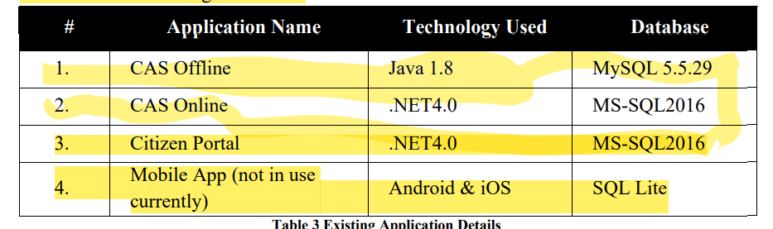
As Is for CCTNS CAS 4.5
Technology Stack for Existing Core Legacy Applications

Slide 14
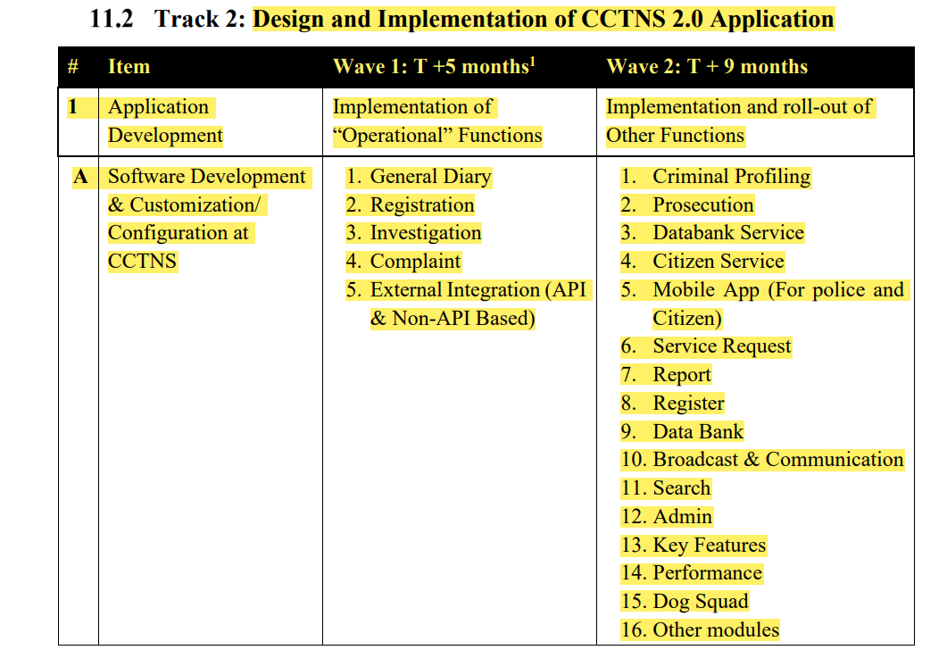
To Be

Slide 15
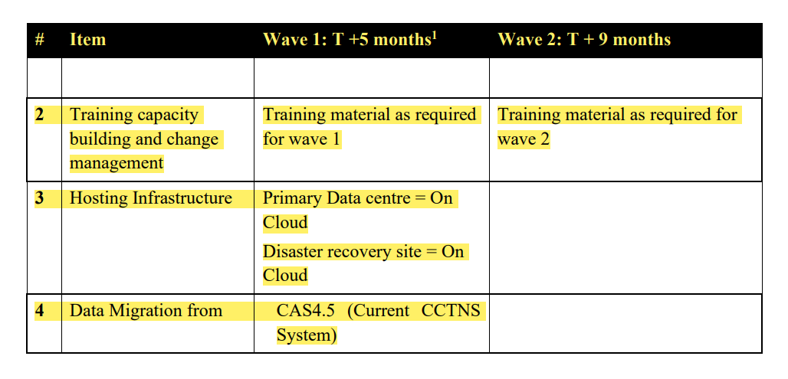
To Be

Slide 16
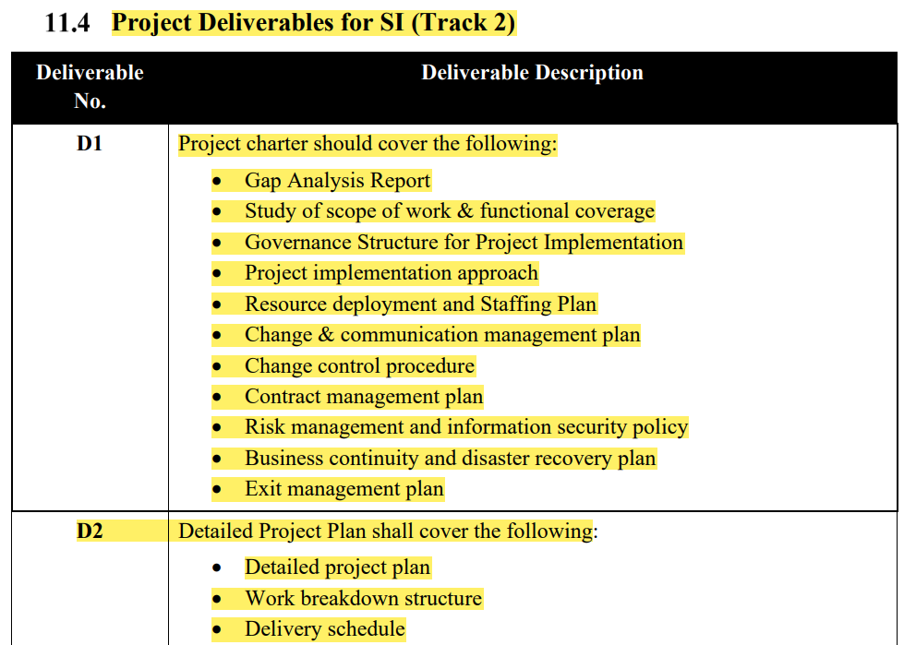
To Be

Slide 17
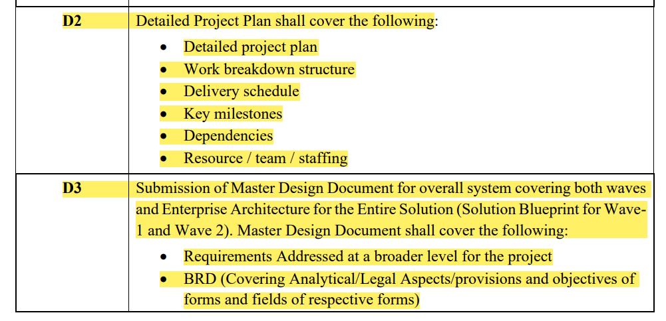
To Be is in table in 32 pointers

Slide 18
Customer Challenges in cctns 1.0
Login of Idam (jsp)
Servlet( valid user, accesslevel)
Tile of odk central(jpeg file)

Slide 19
Design Expectations

